Slide 1
Lecture 6
Stepper Motor and Obstacle Avoidance Sensor
By Dr. Min He

Slide 2
Outline
Introducing three types of motors
Stepper motors and how they work
IR obstacle avoidance sensor
References

Slide 3
Motors
DC Motors
Fast, continuous rotation motors – Used for anything that needs to spin at a high RPM e.g. car wheels, fans, etc.
Servo Motors
Fast, high torque, accurate rotation within a limited angle. Suited for robotic arms/legs or rudder control etc.
Stepper Motors
Slow, precise rotation, easy set up & control. Suited for 3D printers and similar devices where position is fundamental.

Slide 4
Stepper Motors
Advantages
Stable. Can drive a wide range of frictional and inertial loads.
Needs no feedback. The motor is also the position transducer.
Inexpensive relative to other motion control systems.
Standardized frame size and performance.
Plug and play. Easy to setup and use.
Safe. If anything breaks, the motor stops.
Long life. Bearings are the only wear-out mechanism.
Excellent low speed torque. Can drive many loads without gearing.
Excellent repeatability. Returns to the same location accurately.
Overload safe. Motor cannot be damaged by mechanical overload.

Slide 5
Stepper Motors
Disadvantages
Low efficiency. Motor draws substantial power regardless of load.
Torque drops rapidly with speed (torque is the inverse of speed).
Low accuracy. 1:200 at full load, 1:2000 at light loads.
Prone to resonances. Requires microstepping to move smoothly.
No feedback to indicate missed steps.
Low torque to inertia ratio. Cannot accelerate loads very rapidly.
Motor gets very hot in high performance configurations.
Motor will not "pick up" after momentary overload.
Motor is audibly very noisy at moderate to high speeds.
Low output power for size and weight.

Slide 6
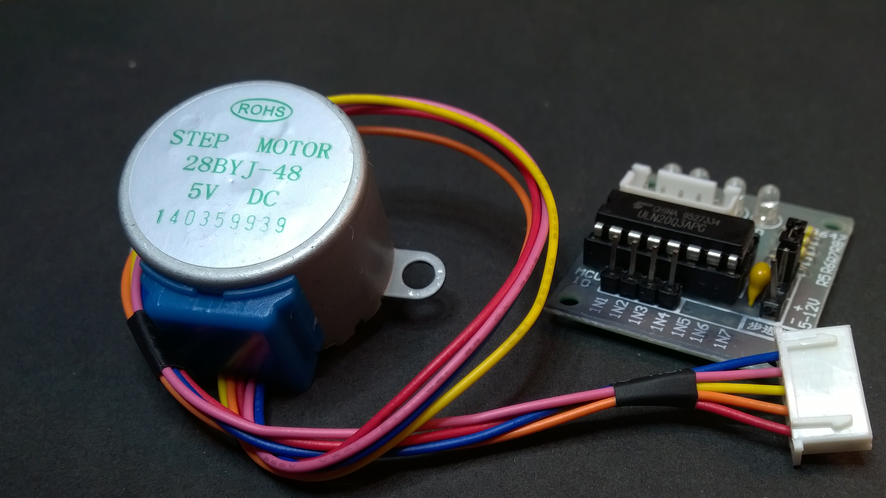
THE 28byj-48 Motor and ULN2003 Drive

Slide 7
28BYJ-48 motor electormagnetics
The 28BYJ-48 is a Unipolar Stepper Motor (as opposed to Bipolar).
With Unipolar motors, you don’t need to change the polarity of the voltages on any give lead. That means that you don’t need an H-Bridge to reverse the polarity.
The common center taps are connected to +5VDC. You then use some circuitry (the ULN2003 Array in this case) to pull the appropriate coil ends to ground to energize their respective half of the coil.
PULLED TO GROUND BY ULN2003
PULLED TO GROUND BY ULN2003
+5VDC

Slide 8
28BYJ-48 motor electrOmagnetics
The 28BYJ-48 is a Unipolar Stepper Motor (as opposed to Bipolar).
With Unipolar motors, you don’t need to change the polarity of the voltages on any give lead. That means that you don’t need an H-Bridge to reverse the polarity.
The common center taps are connected to +5VDC. You then use some circuitry (the ULN2003 Array in this case) to pull the appropriate coil ends to ground to energize their respective half of the coil.

Slide 9
ULN2003 Darlington Array Driver
The ULN2003 houses an array of 7 Darlington Pairs
A Darlington Pair is basically a pair of transistors where the second transistor amplifies the output current of the first transistor.
This gives you a higher current gain than a single transistor and allows the low voltage, low current output of a microcontroller to drive the higher current stepper motor.
The board includes convenient IO and power headers, as well as coil power indicator LEDs
The ULN2003 actually supports seven input/output pairs, but the 28BYJ-48 only needs four (four phases) so only four pins are exposed.

Slide 10
Connecting it all up…
This could be an Arduino, Raspberry Pi, Spark Core, or any other Microcontroller (MCU).
Connect IN1-IN4 on the ULN2003 board to Digital Output pins on your MCU. Use a separate power source for the motor if it needs more volts or amps than your MCU Power Supply can provide.

Slide 11
WAVE DRIVING…
11.25° Step Angle – 32 Steps needed for a single rotor rotation of 360°
Energize a single phase at a time. Magnetizes a single set of teeth. Rotor turns to align it’s magnetic poles with the teeth.
Simplest to understand, but has the largest angle per step, and the lowest torque.

Slide 12
WAVE DRIVING – STEP 1
11.25° Step Angle – 32 Steps needed for a single rotor rotation of 360°
Energize a single phase at a time. Magnetizes a single set of teeth. Rotor turns to align it’s magnetic poles with the teeth.
Simplest to understand, but has the largest angle per step, and the lowest torque.

Slide 13
WAVE DRIVING – STEP 2
11.25° Step Angle – 32 Steps needed for a single rotor rotation of 360°
Energize a single phase at a time. Magnetizes a single set of teeth. Rotor turns to align it’s magnetic poles with the teeth.
Simplest to understand, but has the largest angle per step, and the lowest torque.

Slide 14
WAVE DRIVING – STEP 3
11.25° Step Angle – 32 Steps needed for a single rotor rotation of 360°
Energize a single phase at a time. Magnetizes a single set of teeth. Rotor turns to align it’s magnetic poles with the teeth.
Simplest to understand, but has the largest angle per step, and the lowest torque.

Slide 15
WAVE DRIVING – STEP 4
11.25° Step Angle – 32 Steps needed for a single rotor rotation of 360°
Energize a single phase at a time. Magnetizes a single set of teeth. Rotor turns to align it’s magnetic poles with the teeth.
Simplest to understand, but has the largest angle per step, and the lowest torque.

Slide 16
WAVE DRIVING – STEP 5
11.25° Step Angle – 32 Steps needed for a single rotor rotation of 360°
Energize a single phase at a time. Magnetizes a single set of teeth. Rotor turns to align it’s magnetic poles with the teeth.
Simplest to understand, but has the largest angle per step, and the lowest torque.

Slide 17
WAVE DRIVING – STEP 6
11.25° Step Angle – 32 Steps needed for a single rotor rotation of 360°
Energize a single phase at a time. Magnetizes a single set of teeth. Rotor turns to align it’s magnetic poles with the teeth.
Simplest to understand, but has the largest angle per step, and the lowest torque.

Slide 18
WAVE DRIVING – STEP 7
11.25° Step Angle – 32 Steps needed for a single rotor rotation of 360°
Energize a single phase at a time. Magnetizes a single set of teeth. Rotor turns to align it’s magnetic poles with the teeth.
Simplest to understand, but has the largest angle per step, and the lowest torque.

Slide 19
WAVE DRIVING – STEP 8
11.25° Step Angle – 32 Steps needed for a single rotor rotation of 360°
Energize a single phase at a time. Magnetizes a single set of teeth. Rotor turns to align it’s magnetic poles with the teeth.
Simplest to understand, but has the largest angle per step, and the lowest torque.

Slide 20
FULL STEPPING…
11.25° Step Angle – 32 Steps needed for a single rotor rotation of 360°
Energize two phases at a time. Magnetizes a two adjacent set of teeth. Rotor turns to align it’s magnetic poles to the center of the two teeth (center of the mag field)
Same step angle as wave drive but the best torque and holding power.

Slide 21
FULL STEPPING – Step 1
11.25° Step Angle – 32 Steps needed for a single rotor rotation of 360°
Energize two phases at a time. Magnetizes a two adjacent set of teeth. Rotor turns to align it’s magnetic poles to the center of the two teeth (center of the mag field)
Same step angle as wave drive but the best torque and holding power.

Slide 22
FULL STEPPING – Step 2
11.25° Step Angle – 32 Steps needed for a single rotor rotation of 360°
Energize two phases at a time. Magnetizes a two adjacent set of teeth. Rotor turns to align it’s magnetic poles to the center of the two teeth (center of the mag field)
Same step angle as wave drive but the best torque and holding power.

Slide 23
FULL STEPPING – Step 3
11.25° Step Angle – 32 Steps needed for a single rotor rotation of 360°
Energize two phases at a time. Magnetizes a two adjacent set of teeth. Rotor turns to align it’s magnetic poles to the center of the two teeth (center of the mag field)
Same step angle as wave drive but the best torque and holding power.

Slide 24
FULL STEPPING – Step 4
11.25° Step Angle – 32 Steps needed for a single rotor rotation of 360°
Energize two phases at a time. Magnetizes a two adjacent set of teeth. Rotor turns to align it’s magnetic poles to the center of the two teeth (center of the mag field)
Same step angle as wave drive but the best torque and holding power.

Slide 25
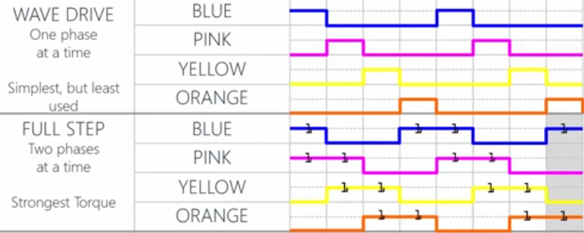
Stepping in Wave Drive and Full Step

Slide 26
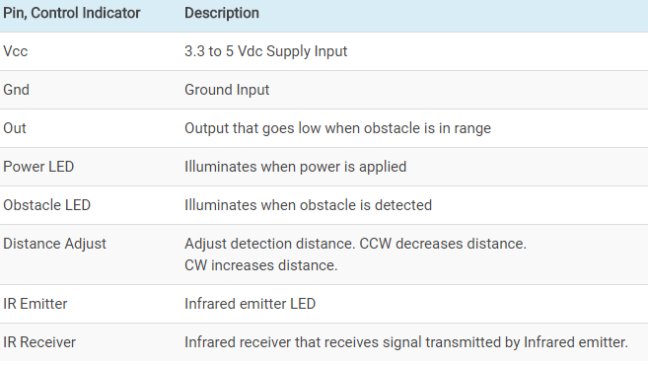
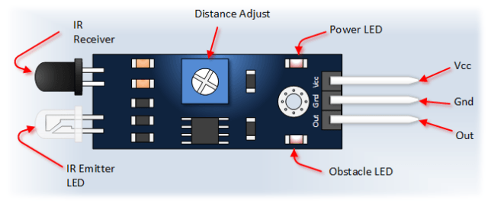
IR Obstacle Avoidance Sensor
Can use the 5 V DC supply from LaunchPad
Effective distance range 2 ~ 30cm; detection angle 35°.

Slide 27
Reference
How to use the 28byj-48 Motor and ULN2003 Drive: https://www.youtube.com/watch?v=B86nqDRskVU
IR Obstacle avoidance sensor: https://www.youtube.com/watch?v=gRtdcxOXojo

